Slide 1
We are PowerCem Technologies

Slide 2
Philosophy
South Emsall Sewage Treatment Works Wetland
To significantly reduce the carbon footprint of the construction
To preserve virgin aggregate resources
To avoid the use of a manufactured membrane
To create a facility that can be maintained simply and safely throughout its intended design life
To use materials that can be fully recycled at end of life of the facility, with zero waste

Slide 3
The Project
South Emsall Sewage Treatment Works Wetland
5 wetland cells covering around 25,300 m²
Provision of storage capacity for storm over flows
Removal by plants of chemicals such as phosphates not addressed by the STW
Accommodates flow of 440l/s

Slide 4
Methodology
South Emsall Sewage Treatment Works Wetland
Soils laboratory tested to prove strength and impermeability, benchmarked against puddle clay
Designed for balanced cut/fill – no spoil to landfill
Vegetation stripped off, topsoil removed and stockpiled
Bulk earthworks carried out to create cell plateaus
Base of cells stabilised in-situ with RoadCem and OPC to a depth of 250mm
Topsoil stabilised ex-situ, placed in 250mm layers and compacted to form the embankments
Embankments formed oversize and trimmed to shape after 1 week
Cell 1 full hydraulic test at capacity plus 25% safety margin

Slide 5
Carbon Footprint
South Emsall Sewage Treatment Works Wetland
Original design – all topsoil to landfill and import equal volume of clay
Estimated 3,000 HGV movements, requiring a 650m long temporary haul road, 2 bridges over the beck and a highway standard junction
Stabilising site won material reduced HGV movements to delivery of RoadCem and cement and plant
The haul road, would have been waste on removal, no longer required
Omission of manufactured liner further reduced carbon footprint
Based on other projects estimated 80% reduction in carbon footprint

Slide 6
Technology
South Emsall Sewage Treatment Works Wetland
Cement and lime ‘glue’ the particles together, resulting in a brittle material with little tensile strength
RoadCem significantly enhances the stabilisation process by wrapping the particles in a needle like matrix
The resultant material has good tensile strength, a high modulus of elasticity and low permeability
Large areas can be stabilised with excellent crack control, such that movement joints are not required
Greater proportion of the cement is included in the hydration process which improves the durability of the stabilised material and reduces cement requirement
Contaminants are locked into the microstructure, no leaching of contaminants
RoadCem can be used with soils which are not suitable for lime, or cement stabilisation such as soils with high organic content and clays with high sulphate content and high-volume change potential

Slide 7
Design and Verification
South Emsall Sewage Treatment Works Wetland
The final layout of the cells and the cut/fill model were carried out by Civil Engineers from Rodgers Leask Ltd
The soil sampling, laboratory testing, geotechnical design and site monitoring and verification were carried out by Geotechnical Engineers from Rodgers Leask Ltd

Slide 8
Maintenance and End of Life
South Emsall Sewage Treatment Works Wetland
The stabilised material forming the bases and embankments of the cells enables mechanical plant to enter the cells for maintenance without damaging the integrity or the water retaining properties
Use of a liner would have made maintenance more difficult
When the cells are eventually decommissioned the stabilised soil can be recycled, either as a growing medium, or as an aggregate for use elsewhere

Slide 9
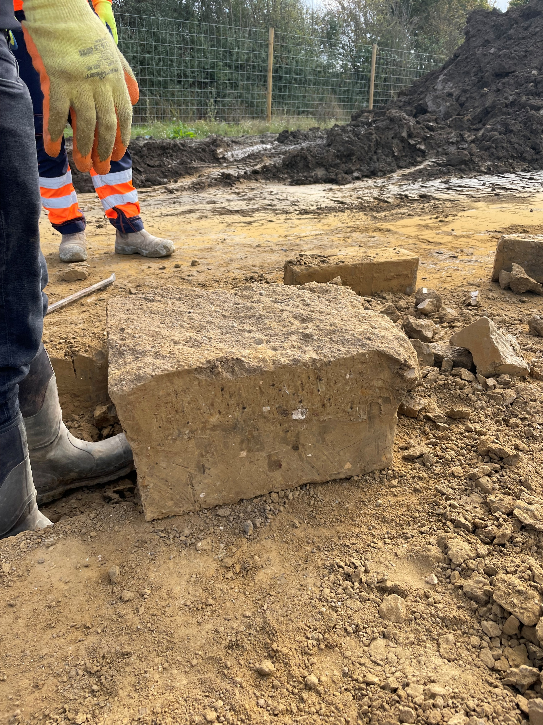
Sawn Sample
South Emsall Sewage Treatment Works Wetland

Slide 10
Video
South Emsall Sewage Treatment Works Wetland

